Slide 1
Sampling
Year 9

Slide 2
Learning Intentions
I will be able to
Describe the impact of sampling
Collect my own data samples
Describe stratified sampling

Slide 3
The littering problem
How bad a problem is littering around Baldivis?
Score
Major problem 4
Occasional problem 3
Minor problem 2
Not a problem 1

Slide 4
The littering problem
The teacher will now number off the students in the class into 5 groups. Remember your number.

Slide 5
The littering problem
Now we will record the results from group 2 only.
Record the number of people in group 2
Calculate their mean response

Slide 6
The littering problem
Repeat this for group 2 and group 3.
Record the number of people in groups 2 and 3
Calculate their mean response (did it change?)

Slide 7
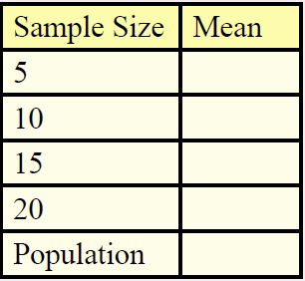
The littering problem
Continue this process adding one more group at a time until the whole class has been recorded (a census of the whole population).

Slide 8
The littering problem
As more people were sampled the results became more accurate. However it was also more work.

Slide 9
24
7
30
Data
Date:
EQ – How can I take a more efficient sample
To improve our sampling we can break a population up into groups, and then sample from each group independently. This is called stratified sampling.

Slide 10
24
7
30
Data
Date:
EQ – How can I take a more efficient sample
To improve our sampling we can break a population up into groups, and then sample from each group independently. This is called stratified sampling.
A stratified sample helps avoid bias because each member of a section of the population has an equal chance of being selected in the sample.

Slide 11
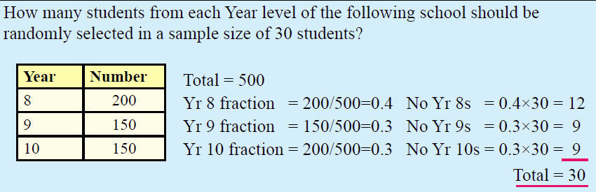

24
7
30
Data
Date:
EQ – How can I take a more efficient sample
A stratified sample helps avoid bias because each member of a section of the population has an equal chance of being selected in the sample.

Slide 12
24
7
30
Data
Date:
EQ – How can I take a more efficient sample
A stratified sample helps avoid bias because each member of a section of the population has an equal chance of being selected in the sample.

Slide 13
24
7
30
Data
Date:
EQ – How can I take a more efficient sample
There are many industries that would want someone who can do stratified sampling. Examples of these are nuclear physics, investment bankers, political analysts, Netflix content managers, climate change researchers, wind farm designers, search and rescue planners and AI game programmers.

Slide 14
Task
Exercise 19.5, Q 1-4, page 265
Complete your summary and make sure your contents page and glossary are up to date
Notes:
Guide students through the question.
Option 2: Dot plots handout (Scaffolded for kids who may need extra help)

